Slide 1
Deeper into Land Use/Land Cover(LULC) Data
what, how, applications and case study
Haolin Li
July 26, 2024
Notes:
[Mic test]
I hope everyone had a wonderful lunch break or tea break. It seems like as I am speaking, the summer Olympic has officially started. It makes me feel bad to be the one stopping you from watching the opening ceremony. I hope everyone still have the chance to catch up with it later.
But annyway
[read the title]

Slide 2
Outline
In our previous lecture…
What is LULC data?
How is LULC data produced?
A simple tutorial of classification of satellite image
Applications of LULC data
Case study: Integrating Cellular Automaton and Markov Chain in LULC change prediction for India
Notes:
So for my presentation today, I would like to take you just a little bit deeper into a very specific type of GIS (or remote sensing) data, that is land use/land cover data, what it is, how it is produced, the applications and finally I will present a case study driven by a course project I did last semester on the change prediction of land use/land cover data.
Hopefully, my presentation today will provide a little bit more understanding about this useful and unique data type (or should I say “data product” from satellite images) and inspire more ideas.

Slide 3
In our previous lecture…
what is land use/land cover?
Notes:
So, let’s get started~

Slide 4
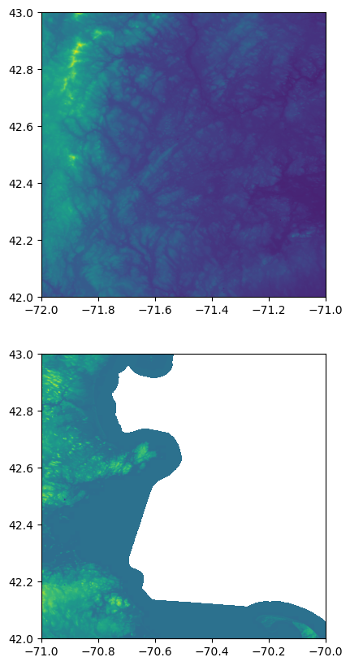
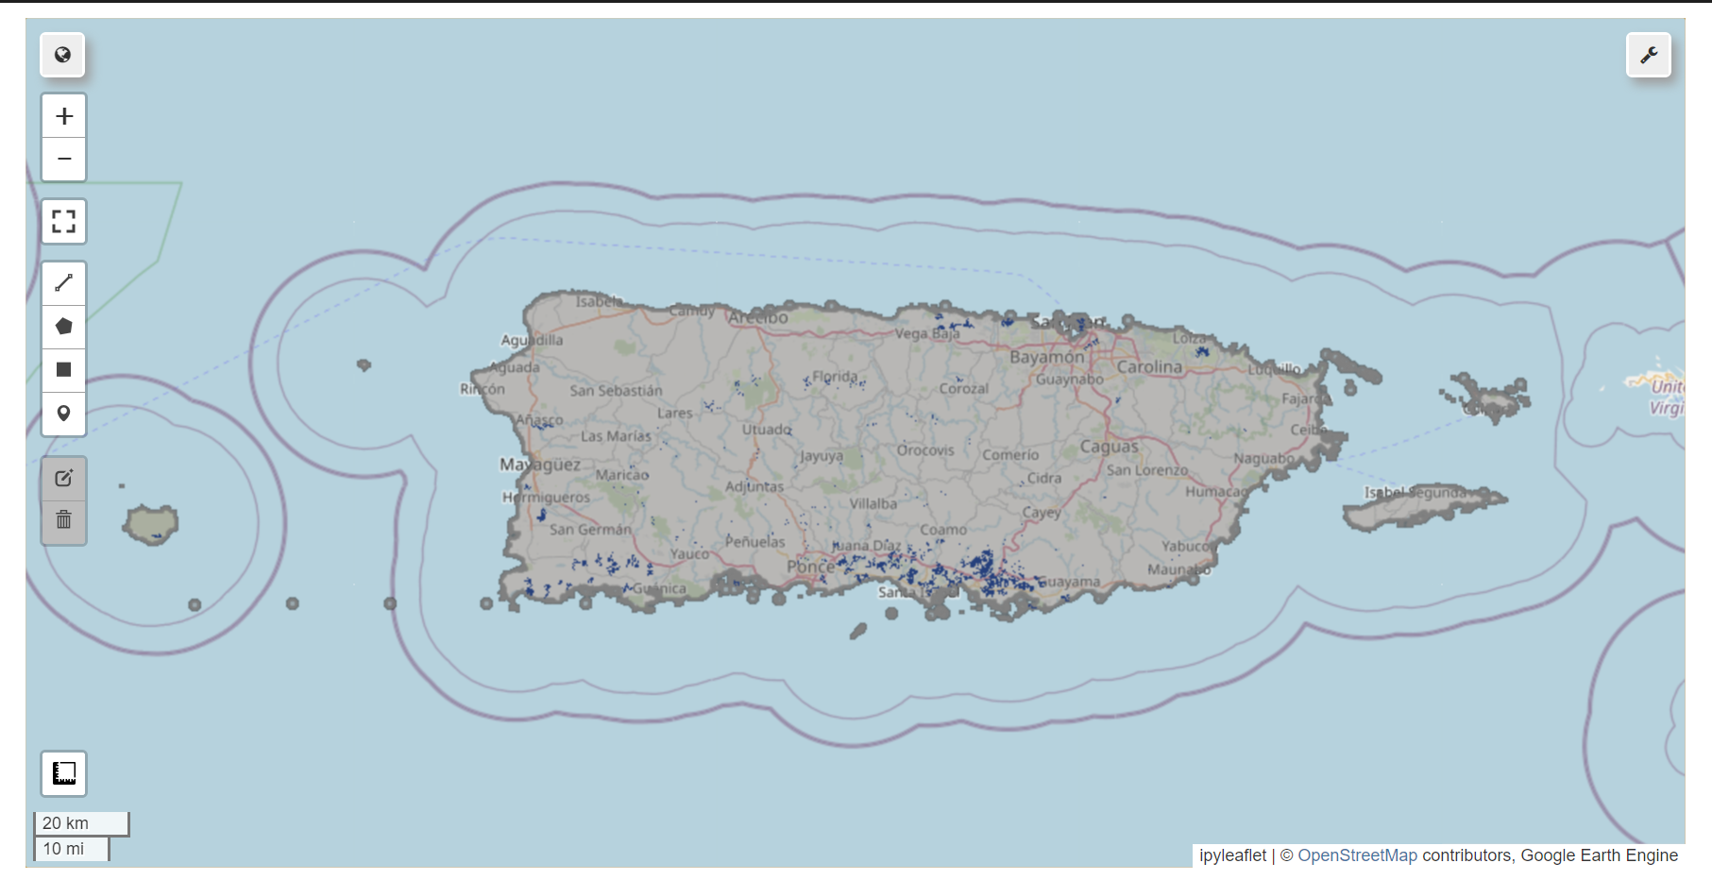
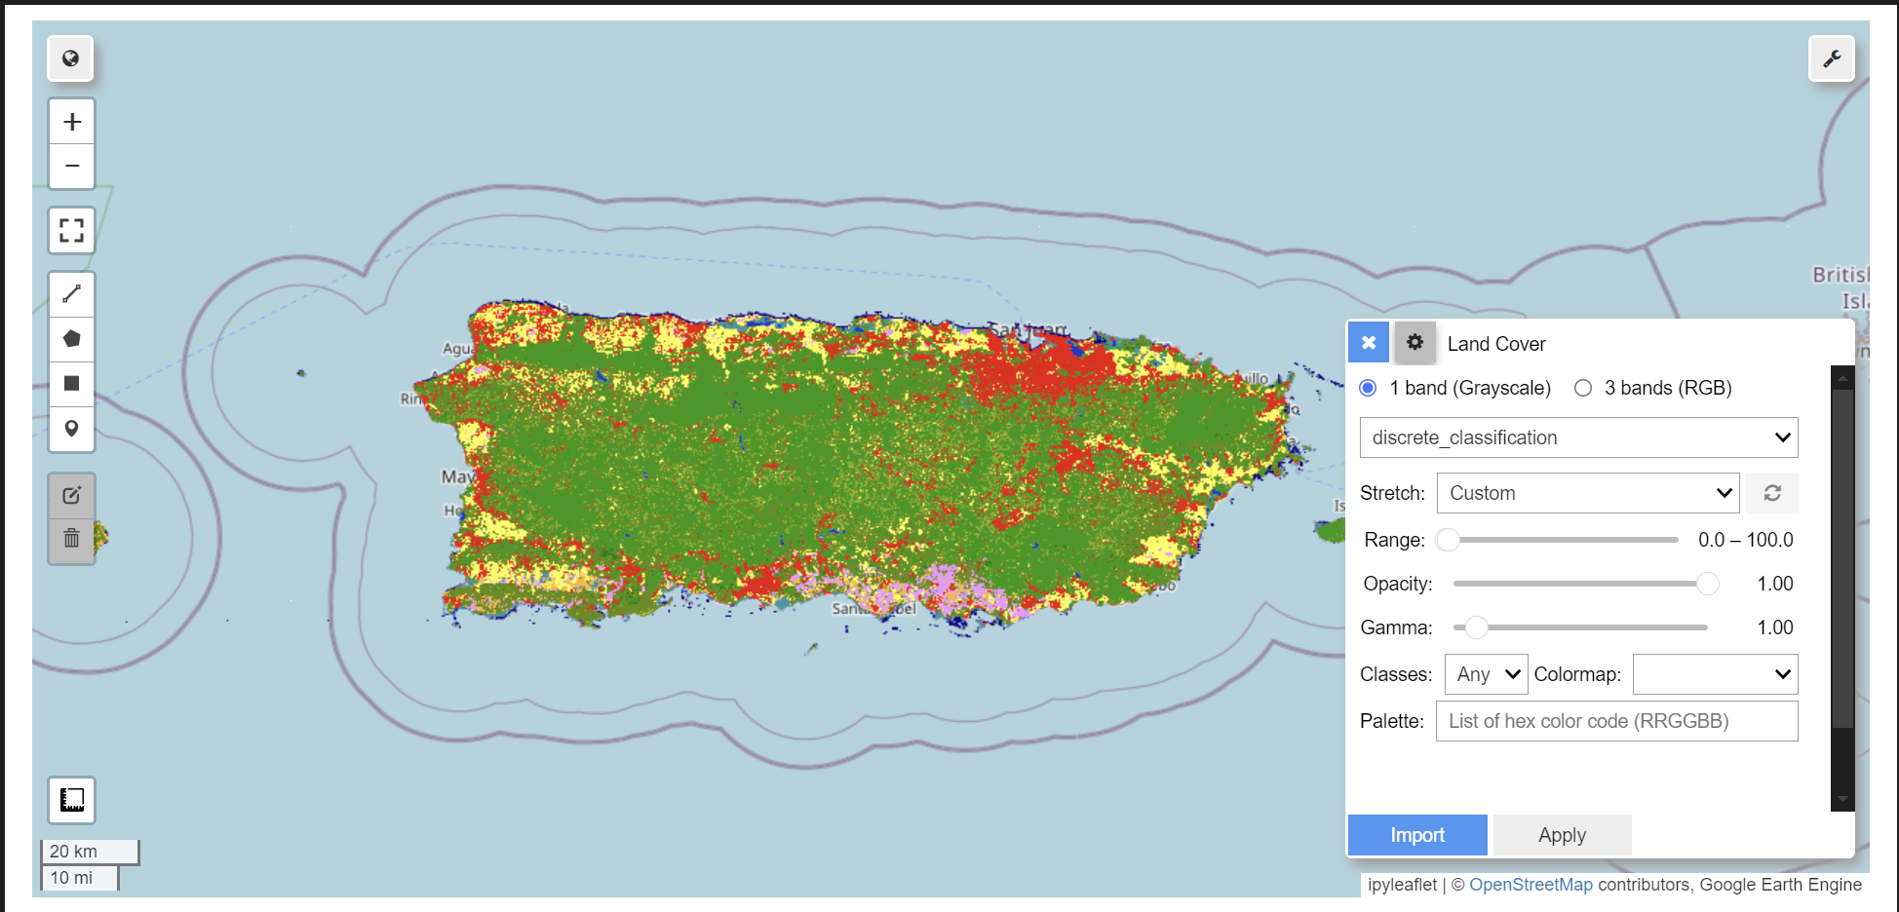
In our previous lectures…
Raster data of elevation (DEM, Digital Elevation Model)
We used SAR Images to determine the inundated region
We calculated NDVI differences
We did statistic analysis
+ population density => people influenced
+ land cover => inundated cropland in hectares
Notes:
In our previous lecture, we got started with raster data types by processing DEM data. We did some simple mosaic and cropping, and then we used GDAL to get the hillshade data product. In the Google Earth Engine part, we used SAR images to extract the inundated region
We calculated NDVI difference to quantify to impact of the flood with Sentinel-2 data. And finally we coupled our region with population density data to investigate the number of people impacted. We coupled the region with land cover data to estimate how many cropland is inundated in hectares.

Slide 5
Introduction to LULC
what is land use/land cover?
Notes:
But here is the question we might have: where do this land cover data come from?
We know that he dataset we used in our notebook has a global coverage in a spatial resolution of 100 meters. And contains 200 categories of land cover types. For example, in our region of interest (Puerto Rico), we can see shrubs, herbaceous vegetation, bareland, snow and ice, etc. Detailed data in this scale and resolution is impossible to acquire by field research. We cannot go to every 100 by 100 cell on the planet and record what type of land it is. [So let’s take a guess – what should be the data source for land classification?]
The satellite images is the source for land classification. But is it true that it is the only source of data for land classification? How exactly can we get classified results from satellite images? First, let’s define what land use and land cover is.

Slide 6
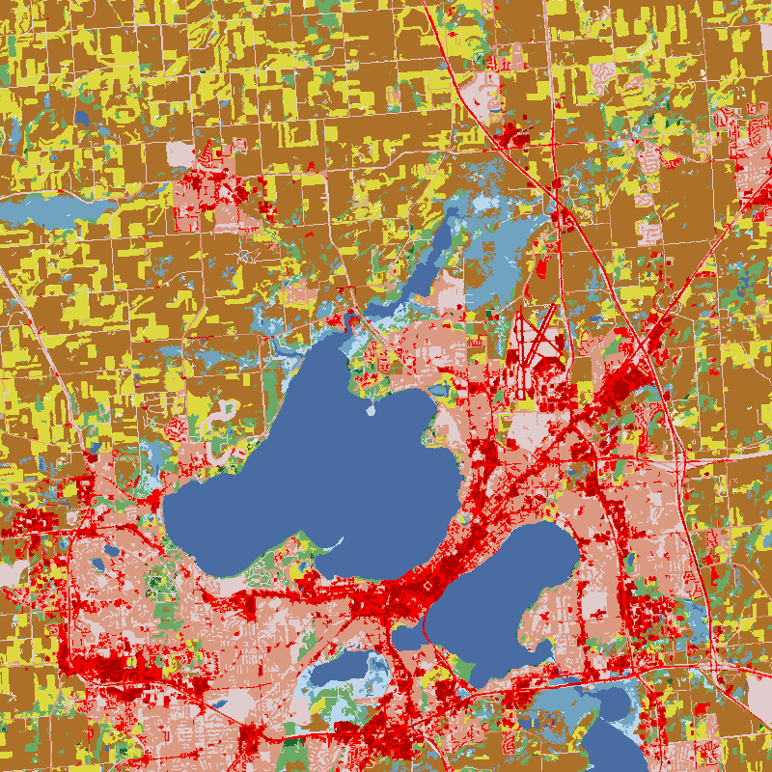
What is LULC data?
Land Cover: the physical material at the surface of the earth vegetation, water, urban land, and bare soil.
Land Use: the human utilization of land residential, commercial, agricultural, recreational, and industrial activities.
Notes:
So the word LULC contains two parts.
Land cover represents the physical material at the surface of the earth. For example we can have vegetation, water, urban land, and bare soil. Land cover is the appearance of land. Thus ideally, we can get the land cover information for every location on earth by looking at the satellite images.
Land use represents how human utilize the land. For example, in a region of a city (which is usually urban land), we can have residential, commercial, agricultural, recreational etc. The utilization of land does not necessarily affect the appearance so land use data cannot always be directly extracted from satellite images.

Slide 7
What is LULC data?
Combines information on
how humans utilize the land (Land Use)
with the physical characteristics of the earth's surface (Land Cover)
to provide a comprehensive understanding of the landscape for environmental, planning, and management purposes
Notes:
If we combine land cover with land use, we can provide a comprehensive understanding of the landscape for environmental, planning, and management purposes. That is to say, we can not only study the change of the natural surface of the earth (for example, deforestation), but also study how cities developed throughout the years.
Some notes on LULC data:
Given a specific location, the LULC type is fixed and unique
Categorical, no necessary order
The color (symbology) is separate from the data, but it is good practice to assign intuitive colors to LULC types

Slide 8
How is LULC data produced?
from satellite images to LULC data products
Notes:
Great, now that we have our term specified, let’s move on to see how exactly is LULC data produced from satellite images.

Slide 9
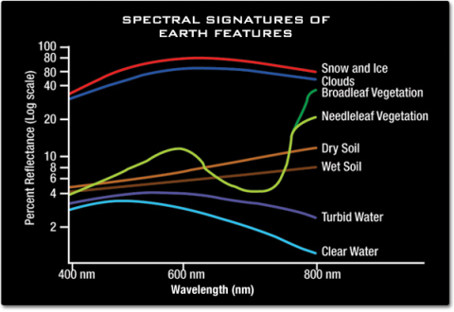
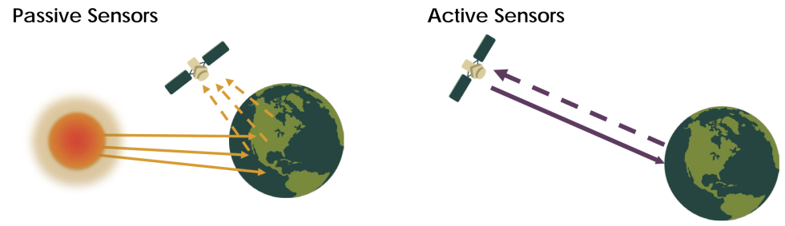
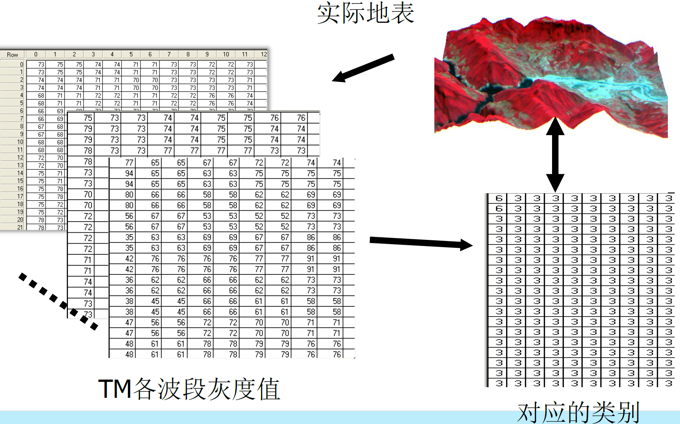
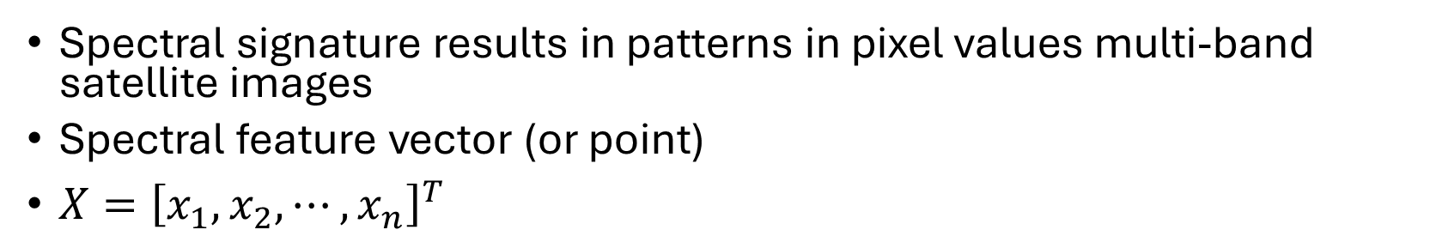
The physical foundations of satellite images
Spectral signature results in patterns in pixel values multi-band satellite images
Spectral feature vector (or point)
$X={\left[x_{1}, x_{2}, ⋯, x_{n}\right]}^{T}$
Notes:
Let’s recall what we have learnt in the class.
We know that there are mainly two types remote sensing depending on whether the platform is actively emitting radiation to the earth surface: passive remote sensing and active remote sensing. The sensor that is equipped in the platform receive the reflected radiation and convert into digital signals and store in images (usually multi-band).
During this process, different types of land cover, due to unique characteristics of reflex (called spectral signature) will form patterns in pixel values multi-band satellite images. We can then use this pattern to classify the points.
We can use X to represent the pixel values of n bands for a certain cell. All the possible points of X form the feature space which is in the same dimension of the number of bands.

Slide 10
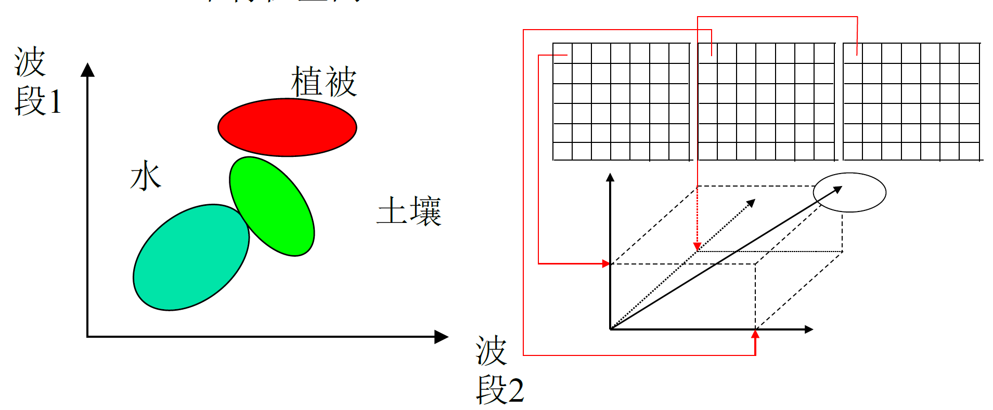
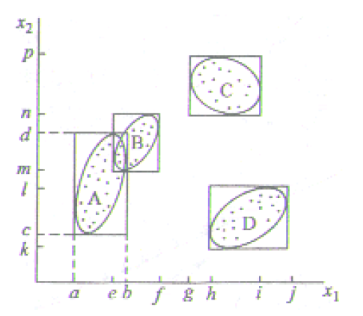
From satellite images to land cover types…
Pixels in similar land cover type will have close distance to each other in the feature space (n-dimension)
Classification of land cover types is like classification of “points clouds” in the feature space
Notes:
Due to the spectral signature, pixels in similar land cover type will have close distance to each other in the feature space.

Slide 11
A simple tutorial of classification of satellite image
GitHub Repository: https://github.com/HumblePasty/lulc-classification-tutorial
Tutorial: https://github.com/HumblePasty/lulc-classification-tutorial/blob/master/lulc_classification_tutorial.ipynb
Now let’s open the notebook and produce our own LULC data!
cd ~/
[ -d "my_folder" ] && rm -r "my_folder"
git clone https://github.com/HumblePasty/lulc-classification-tutorial.git
cd lulc-classification-tutorial
Notes:
Depending on whether the classification method is using labelled data, the classification methods can be categorized into supervised and unsupervised methods.
In industry, the LULC data products are produced by professional software like ERDAS, ENVI
Here I prepared a simple tutorial in python on satellite image classification with two simple methods. I’ll paste the command in the chat and everyone can open their JupyterHub instance and clone the github repository and let’s continue with some coding.

Slide 12
Coding Time
Jupyter Notebook

Slide 13
What are the applications of LULC data?
why do I care about LULC data?

Slide 14
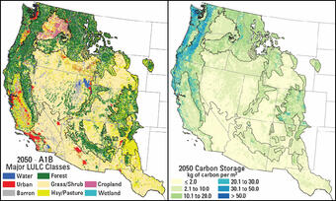
Applications of LULC data
Urban Planning and Development
Identifying suitable areas for new infrastructure.
Managing urban sprawl and preventing overdevelopment.
Agricultural Monitoring
Assessing crop health and yield.
Planning irrigation and resource management.
Environmental Management
Monitoring deforestation and habitat destruction.
Assessing the impact of climate change.
Disaster Management
Mapping flood-prone and wildfire risk areas.
Planning evacuation routes and resource allocation.
Natural Resource Management
Tracking changes in water bodies and forest cover.
Managing conservation efforts and protected areas.
Climate Modeling
Providing data for predicting weather patterns.
Assessing the impact of land cover changes on climate.
Notes:
Land Use and Land Cover (LULC) data is essential for various practical applications. It helps urban planners find suitable areas for new infrastructure and manage urban growth. In agriculture, it assesses crop health and plans irrigation. For environmental management, it monitors deforestation and the effects of climate change. During disasters, LULC data maps flood and fire risks, aiding in evacuation planning. It also tracks changes in natural resources like water and forests, helping conservation efforts. Lastly, it assists in predicting weather patterns and understanding climate impacts, making it a valuable tool for many fields.

Slide 15
Case Study: Integrating Cellular Automaton (CA) and Markov Chain in LULC Change Prediction
a prediction of LULC change in urban environment in Delhi, India
Notes:
I hope everyone is good with the coding part

Slide 16
Basic ideas…
LULC data is raster data.
The grid system is constant and the values are changing
We want to predict how LULC change (within a certain area) in the future
How many?
Where?
To which type?
with historic LULC data
… and GIS data
“driving factors”
the underlying factors that are causing the changes
… with consideration of neighbor effect
If my neighbors have a certain LULC type, then I have the tendency to become that type in the next time step
A model that integrates all these
Notes:
[Basic ideas]
Typically in a time-series LULC data, the grid system is will not change over time. That means
What we want to do is to predict how LULC change (within a certain area) in the future. That brings out three important questions which we will one by one solve in later sections:
-
-
-
Data source
So how?

Slide 17
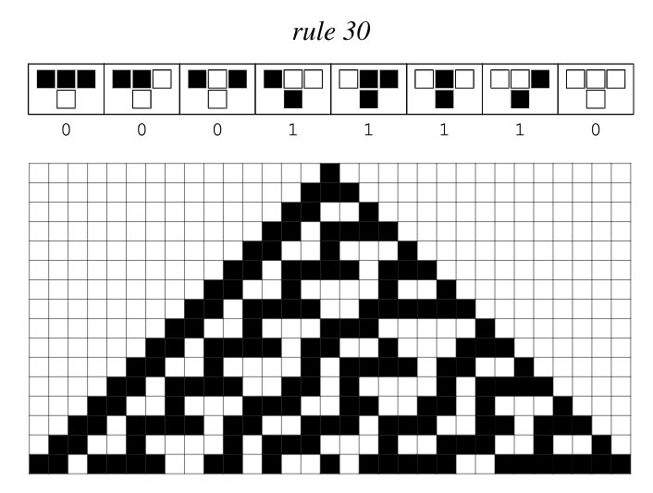
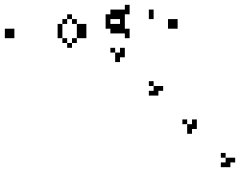
What is Cellular Automaton (CA)?
Mathematical model on a grid of cells.
Cells change state based on neighboring cells.
Rules define how cells evolve over time.
Example: Conway's Game of Life
Notes:
[Interaction, How many know CA before?]
A Cellular Automaton is a mathematical model that consists of a grid of cells. Each cell in the grid can exist in a number of different states. The state of each cell changes over time based on a set of rules and the states of its neighboring cells.
For example, in Conway's Game of Life, each cell on the grid can either be alive or dead. The cells change state according to simple rules: a living cell with too few or too many neighbors dies, while a dead cell with exactly three living neighbors becomes alive. This process repeats over many iterations, creating fascinating patterns and behaviors. It is amazing how simple rule can result in complex patterns. CA is used to simulate real-world phenomena and systems.
This give me inspiration to LULC data. Imagine that the cells represents the pixels and the states represents the different land use land cover types. And the change of types are also guided by the simplest rule. It would be amazing to see that
This integrates the neighbor effect into our model

Slide 18
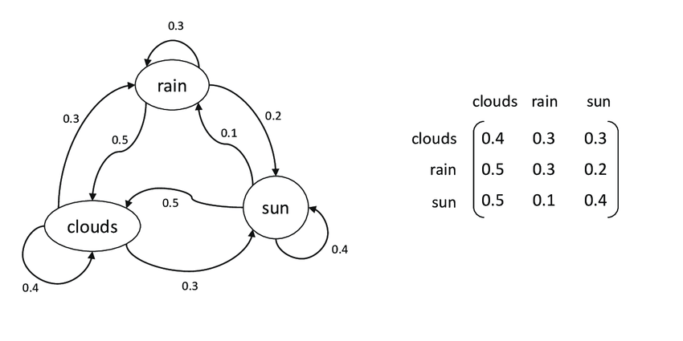
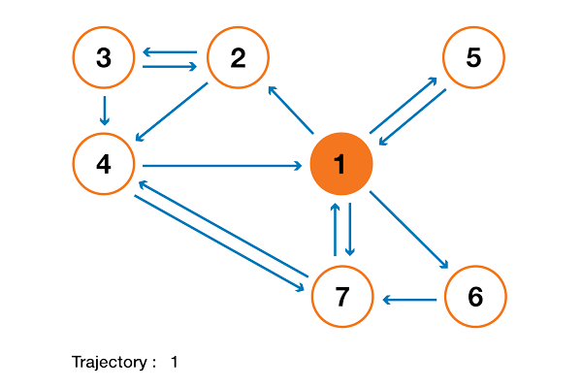
What is Markov Chain?
Sequence of events with probabilities.
Transition from one state to another.
No memory of past events.
Used in modeling random processes.
Example: A simple weather prediction model
Notes:
A Markov Chain is a mathematical model that represents a sequence of events where the probability of each event depends only on the state attained in the previous event. In other words, it has no memory of past events beyond the most recent one.
This model is useful for modeling random processes where each state transition happens with a certain probability. For example, the weather could be modeled as a Markov Chain: if it is sunny today, there is a certain probability it will be sunny tomorrow, and a different probability that it will be rainy, without needing to consider the weather from days before.
Markov chain can be described by a transition matrix. Entries meaning
In land use change prediction, we can understand Markov Chain when we look at a single cell:
Each cell has different tendency of changing into different types. For example, in a growing city environment,
We can assume that how the cell change does not depend on the historic data(this is for simplicity)
With Markov chain, we can answer the questions of how many cells are changing, where the cells will most likely turn into in the next time step

Slide 19
Why do CA & Markov Chain work in LULC change Prediction?
Why Markov Chain?
LULC change along the years~ discrete time Markov Chain
Different land use types (states) show different transition characteristics
Why Cellular Automaton?
Cells ~ Grid
Changing in Values ~ Landuse changes
Observe simple rules in the micro level (land use majority), complex behaviours in the macro level
What GIS data?
The knowledge we have to explain the change in land use.
The driving force of change
Existing work and inspiration
Notes:
Explain the GIS data:
Solves the problems of “where”
The reason why a cell change in the future is that the current state is not the most suitable state for this cell
And whether a

Slide 20
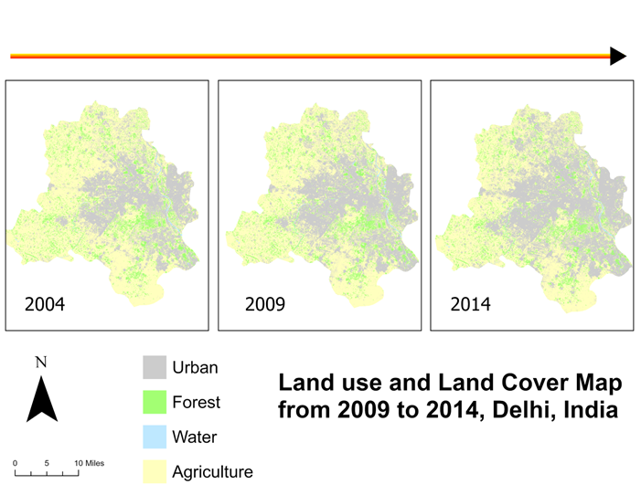
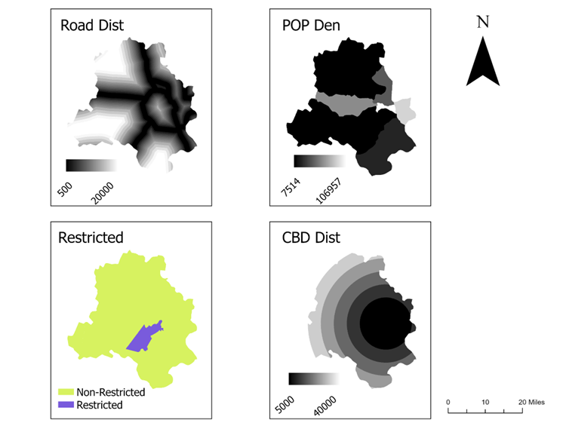
Our data source and experiment area…
Land use change in Delhi
Driving factors
Notes:
In our experiment
Rapid urbanization
Deforestation
Rapid depletion of the water

Slide 21
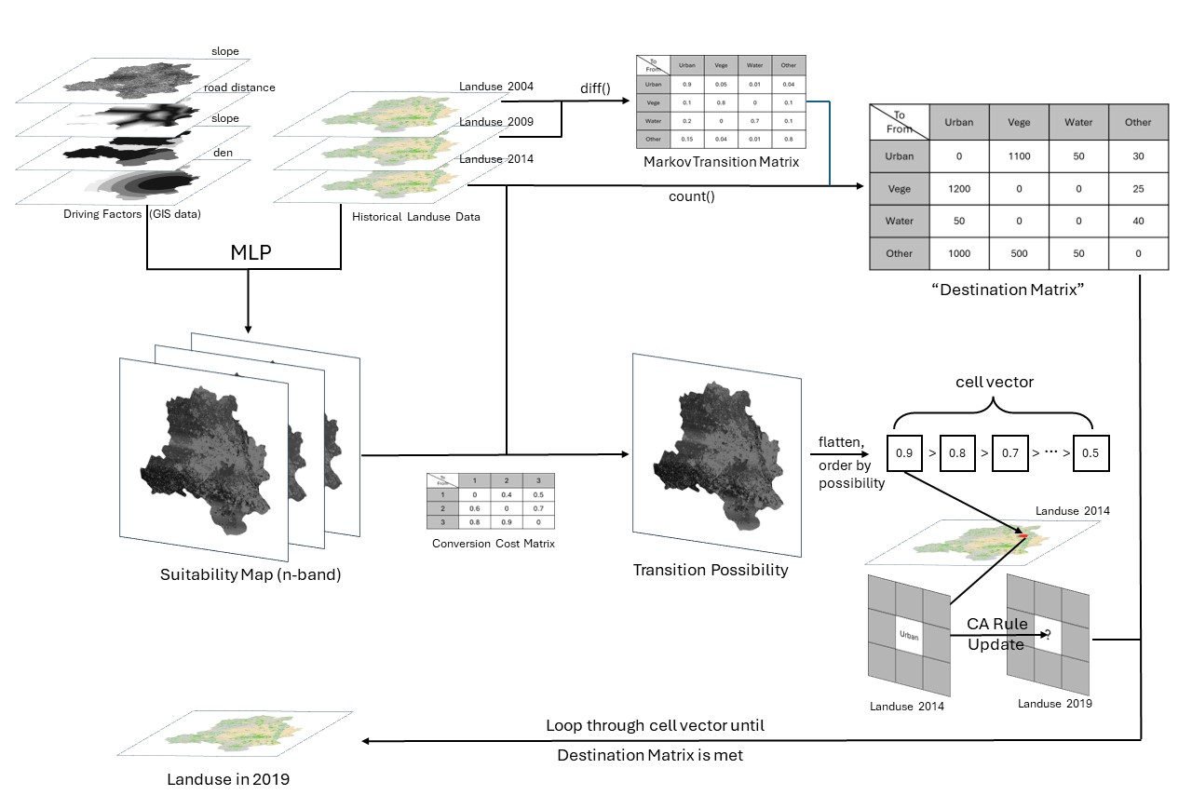
The overall diagram
Notes:
I need to think further about what to cover and what to remove for the final presentation

Slide 22




Implementation
Python (Coding)
PyTorch (MLP, suitability data)
Cupy (GPU Computing)
ArcGIS (Visualization & mapping)
GitHub Repository: https://github.com/HumblePasty/complex-modelling/tree/master/FinalProject

Slide 23
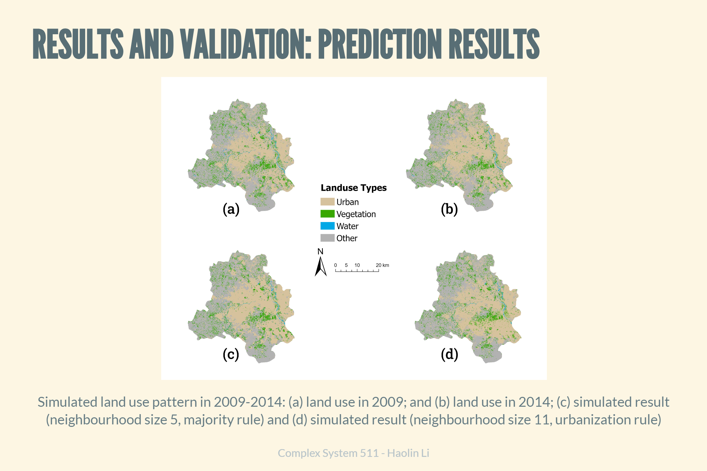
Let’s see how our model perform in prediction

Slide 24
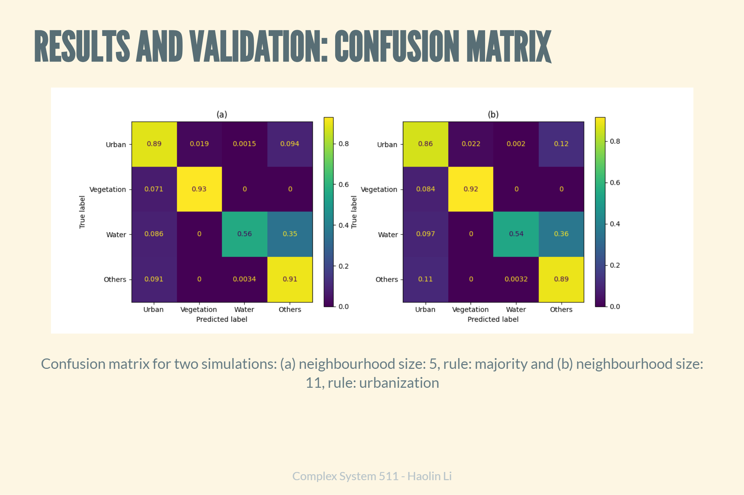
Let’s see how our model perform in prediction

Slide 25
Conclusion
“Smooth” outcome like in voting model
Mostly good, but poor predicting result for water area
Conversion cost matrix
Random changes (majority rule)
Increasing neighborhood did not help
Time-consuming calculation
Markov Chain / CA?
Too restrictive on changes and may not meet the goal
Further works / improvements
Better driving factors
Adding random variable(s) to the model
More explicit and detailed CA ruleset

Slide 26
Reference (main)
Guan, DongJie, et al. "Modeling urban land use change by the integration of cellular automaton and Markov model." Ecological modelling 222.20-22 (2011): 3761-3772. https://doi.org/10.1016/j.ecolmodel.2011.09.009
Mansour, Shawky, Mohammed Al-Belushi, and Talal Al-Awadhi. "Monitoring land use and land cover changes in the mountainous cities of Oman using GIS and CA-Markov modelling techniques." Land use policy 91 (2020): 104414. https://doi.org/10.1016/j.landusepol.2019.104414.
Rahnama, Mohammad Rahim. "Forecasting land-use changes in Mashhad Metropolitan area using Cellular Automata and Markov chain model for 2016-2030." Sustainable Cities and Society 64 (2021): 102548. https://doi.org/10.1016/j.scs.2020.102548
López, Erna, et al. "Predicting land-cover and land-use change in the urban fringe: A case in Morelia city, Mexico." Landscape and urban planning 55.4 (2001): 271-285. https://doi.org/10.1016/S0169-2046(01)00160-8
Veldkamp, Antonie, and Eric F. Lambin. "Predicting land-use change." Agriculture, ecosystems & environment 85.1-3 (2001): 1-6. https://doi.org/10.1016/S0167-8809(01)00199-2

Slide 27
Thank you!!!

